Slide 1
ISOMAP and UMAP: Non-linear Dimensionality Reduction Techniques

Slide 2
The Challenge: High-dimensional data is difficult to interpret, visualize, and use
effectively in machine learning models due to the "curse of dimensionality.“
The Goal: Reduce the number of features (dimensions) while preserving the meaningful
structure of the data.
Why It Matters: Dimensionality reduction enables:
-Visualization: Seeing the shape of your data in 2D or 3D.
-Preprocessing: Improving the performance and speed of ML models.
-Noise Reduction: Focusing on the most important signals in the data.

Slide 3
Dimensionality Reduction Overview
Linear vs. Non-Linear Approaches
Linear Methods (e.g., PCA): Assume the data lies on a flat, linear subspace. They project data onto a lower-dimensional plane. This is fast but fails for complex, curved data.
Non-Linear Methods (Manifold Learning): Assume the data lies on a low-dimensional, curved surface called a manifold, which is embedded in the high-dimensional space.
Our Focus: Isomap and UMAP are two manifold learning techniques designed to "unfold" these complex structures.

Slide 4
Understanding Manifold Learning
Core Idea: A dataset that looks complex in 3D (like a Swiss roll) is intrinsically
simple—it's just a 2D sheet that has been rolled up.
Euclidean Distance: The straight-line distance between two points. This can be
misleading as it cuts "through" the manifold.
Geodesic Distance: The shortest path between two points along the surface of the manifold.
This represents the true relationship between the points.
The Goal: Manifold learning techniques aim to create a low-dimensional view of the
data that preserves the geodesic distances.

Slide 5
Isometric Mapping (Isomap)
What it is: A non-linear dimensionality reduction technique that preserves
the global geodesic distances between all data points.
Core Principle: It provides a simple way to estimate the intrinsic geometry of a
dataset by treating data points as nodes in a graph.
How it Works: Isomap combines the strengths of two classical algorithms:
1. A graph-based method (like Dijkstra's or Floyd-Warshall) to
approximate geodesic distances.
2. Classical Multidimensional Scaling (MDS) to find a low-dimensional
embedding that preserves those distances.

Slide 6
How Does Isomap Work?
Calculate Pairwise Distances: First we find the Euclidean distances between all pairs of data points.
Find Nearest Neighbors: For each point find the closest other points based on distance.
Create a Neighborhood Graph: Connect each point to its nearest neighbors to form a graph.
Calculate Geodesic Distances: Use algorithms like Floyd-Warshall to measure the shortest paths between points by following the graph connections.
Perform Dimensional Reduction: Move points into a simpler space while keeping their distances as accurate as possible.

Slide 7
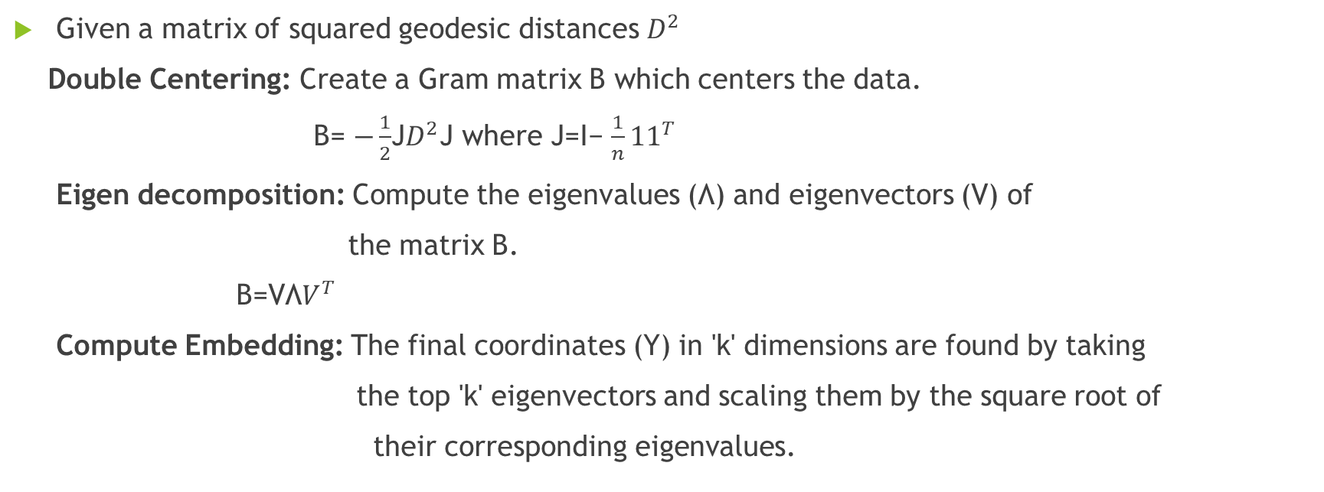
Multidimensional Scaling (MDS)
Given a matrix of squared geodesic distances $D^{2}$
Double Centering: Create a Gram matrix B which centers the data.
B= $−\frac{1}{2}$​J$D^{2}$J where J=I− $\frac{1}{n}{11}^{T}$
Eigen decomposition: Compute the eigenvalues (Λ) and eigenvectors (V) of
the matrix B.
B=VΛ$V^{T}$
Compute Embedding: The final coordinates (Y) in 'k' dimensions are found by taking
the top 'k' eigenvectors and scaling them by the square root of
their corresponding eigenvalues.

Slide 8
Isomap – Pros & Cons
Advantages
Captures Non-Linearity: Effectively finds and preserves global non-linear structures.
Preserves Global Geometry: Excels at retaining the overall shape and arrangement of
the data.
Globally Optimal: Guarantees an optimal solution for the given neighborhood graph.
Disadvantages
Computationally Expensive: Calculating all-pairs shortest paths is slow for
largedatasets (e.g.,O(N2logN)).
Sensitive to Parameters: The choice of neighbors ('k') can significantly impact the result.
Topological Instability: Can fail if the manifold has "holes" or is not well-connected.

Slide 9
Applications of Isomap
Visualization: It makes it easier to see complex data like face images by turning it
into 2D or 3D form so we can understand it better with plots or graphs.
Data Exploration: It helps to find groups or patterns in the data that might be hidden when
the data has too many features or dimensions.
Anomaly Detection: Outliers or anomalies in the data can be identified by understanding
how they deviate from the manifold.
Pre-processing for Machine Learning: It can be used as a pre-processing step before applying
other machine learning techniques improve model performance

Slide 10
UMAP – Introduction
What it is: A novel manifold learning technique for general-purpose, non-linear
dimensionality reduction.
Mathematical Foundation: Grounded in Riemannian geometry and algebraic topology.
Core Principle: UMAP builds a fuzzy topological representation of the data and then
optimizes a low-dimensional embedding to be as structurally similar as possible.
Key Advantage: It is extremely fast and excels at preserving both local neighborhood
structure and global data structure.

Slide 11
UMAP – Step-by-Step Algorithm
Construct High-Dimensional Graph:
-Find the nearest neighbors for each data point (can use fast approximation methods).
-Build a fuzzy simplicial set, which is a weighted graph representing the topological
structure of the data in high dimensions.
Find Low-Dimensional Embedding:
-Initialize points randomly in the low-dimensional space.
-Optimize the positions of these points to make their fuzzy topological structure
match the high-dimensional one. This is done by minimizing cross-entropy using
Stochastic Gradient Descent (SGD).

Slide 12
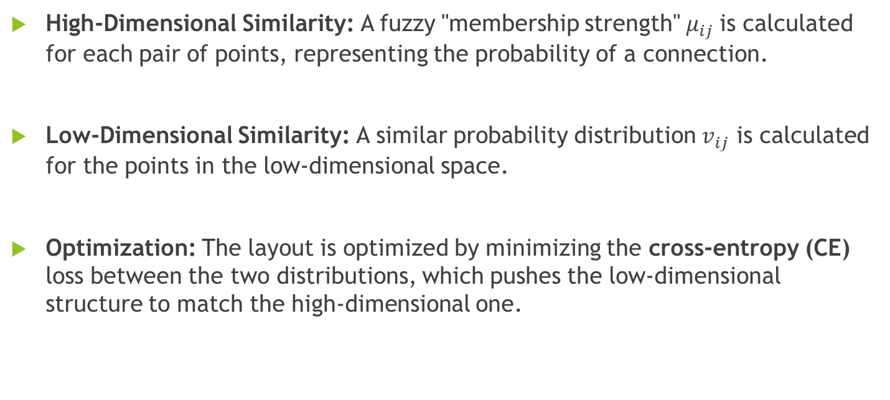
UMAP – Mathematics : Topological Modeling &
Cross-Entropy
High-Dimensional Similarity: A fuzzy "membership strength" $μ_{ij}$​is calculated for each pair of points, representing the probability of a connection.
Low-Dimensional Similarity: A similar probability distribution $v_{ij}$​ is calculated for the points in the low-dimensional space.
Optimization: The layout is optimized by minimizing the cross-entropy (CE) loss between the two distributions, which pushes the low-dimensional structure to match the high-dimensional one.

Slide 13
UMAP – Pros & Cons
Advantages
Fast & Scalable: Highly efficient and can run on datasets with millions of points.
Excellent Structural Preservation: Balances local and global structure better than
many alternatives (like t-SNE).
Flexible: Supports various distance metrics, supervised, and semi-supervised modes.
Disadvantages
Non-Deterministic: Results can vary slightly between runs due to its stochastic nature.
Hyperparameter Tuning: Requires tuning n_neighbours and min_dist for optimal results

Slide 14

Isomap vs. UMAP – Comparison
Feature | Isomap | UMAP
Core Principle | Preserving Geodesic Distance | Preserving Topological Structure
Focus | Global Structure | Local and Global Balance
Scalability | Poor (does not scale well past ~10k points) | Excellent (scales to millions of points)
Speed | Slow (O( )) | Very Fast (O(NlogN))
$$N^{2 }logN$$
Use Isomap when: You have a small-to-medium dataset and preserving the true global
geometric distances is the top priority.
Use UMAP when: You need fast, scalable visualization or preprocessing for a large dataset,
and a balance between local and global structure is desired.

Slide 15
Real-World Use Cases
Data Visualization: Creating insightful 2D/3D plots from high-dimensional data, such as:
- Image datasets (e.g., MNIST, Fashion-MNIST).
- Text embeddings from models like Word2Vec or BERT.
- Genomic or single-cell RNA sequencing data.
Data Exploration & Clustering: Identifying natural groupings, patterns, and outliers in
complex datasets before formal modeling.
Preprocessing for Machine Learning: Using the low-dimensional output as features to
train faster and sometimes more accurate downstream models.
Anomaly Detection: Identifying points that are far from the main data manifold,
which often represent anomalies.

Slide 16
REFERENCES
Isomap Original Paper: Tenenbaum, J. B., de Silva, V., & Langford, J. C. (2000).
A global geometric framework for nonlinear dimensionality reduction.
Science, 290(5500), 2319-2323.
UMAP Original Paper: McInnes, L., Healy, J., & Melville, J. (2018).
Umap: Uniform manifold approximation and projection for dimension reduction.
arXiv preprint arXiv:1802.03426.

Slide 17
THANK YOU

